Slide 1

Clustering By Stock Fundamentals
By Adam Parente

Slide 2
Why Cluster by Company Metrics
There are thousands of stocks to potentially invest in
Grouping stocks is fundamental to many strategies
Grouping by industry and sector can be somewhat arbitrary
Generate more dynamic alternative groupings
Identify unique trading opportunities

Slide 3
The Dataset
SimFim Bulk Data
One of many financial data sellers
The free data available
From Q1 2016 to Q4 2018
Not enough cases in earlier years
More recent quarters behind paywall
Each quarter has at least 1000 stocks
Large amount of missing data
Almost 20% of cells are missing

Slide 4
Variables
There are about 30 accounting styled variables
Of those the most important variables are:
Retained Earnings per Share
Total Assets per Share
Liquid Capital (Cash) per Share
Percent Change in Cash

Slide 5
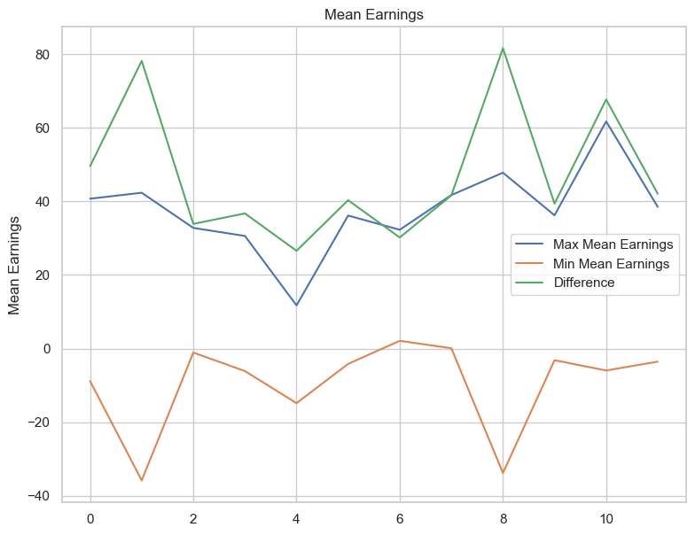
Quarterly High – Low Earnings

Slide 6
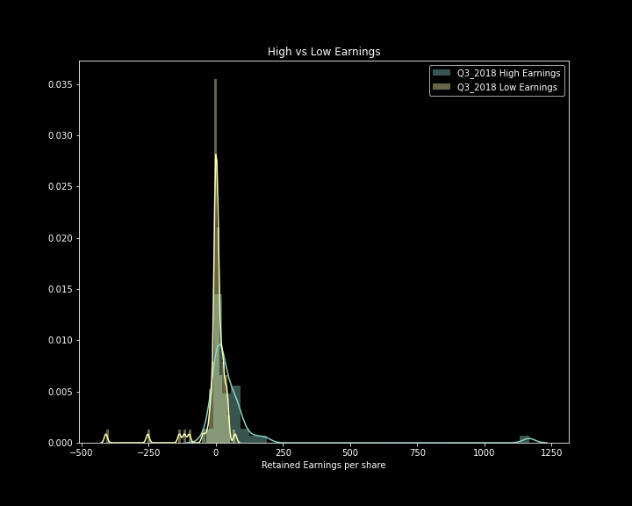
Bad Earnings Clustering

Slide 7
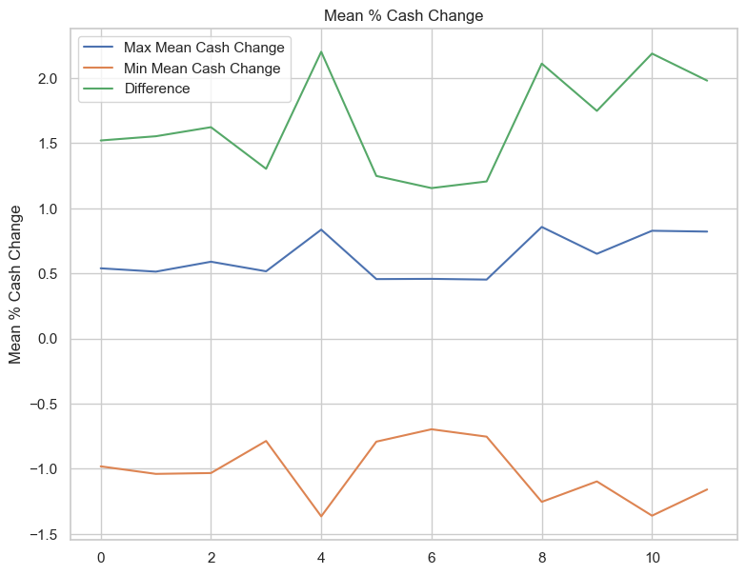
Quarterly High – Low Cash Change

Slide 8
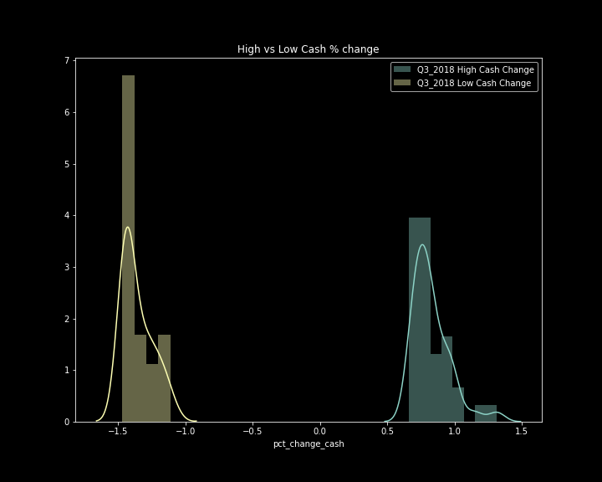
Good Cash Change Clustering

Slide 9
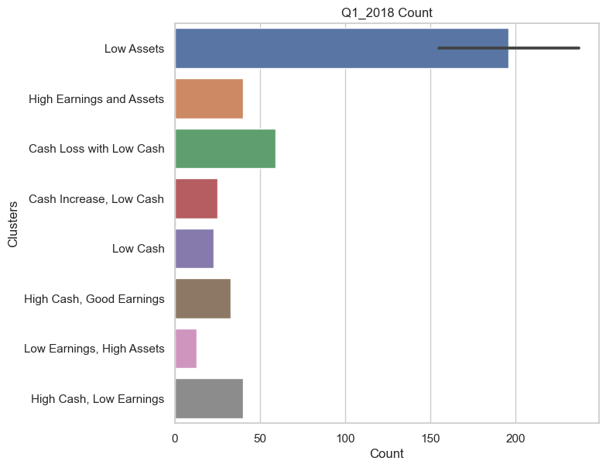
Q1 2018 Group Size

Slide 10
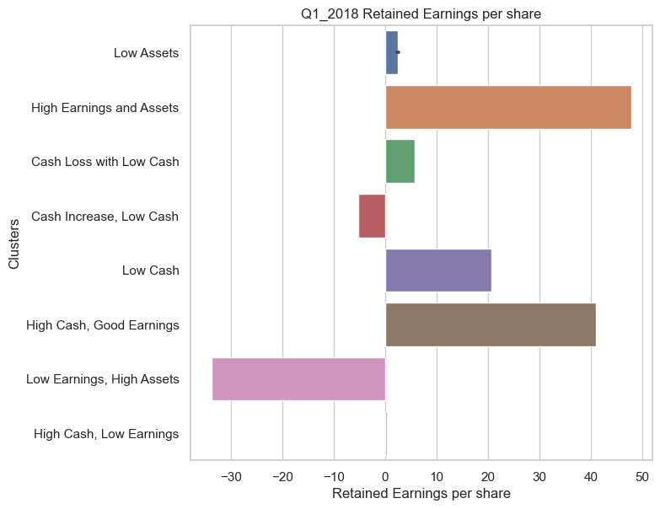
Q1 2018 Retained Earnings

Slide 11
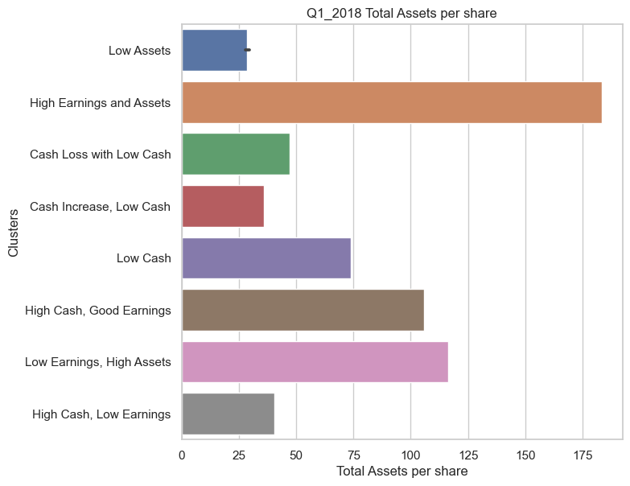
Q1 2018 Total Assets

Slide 12
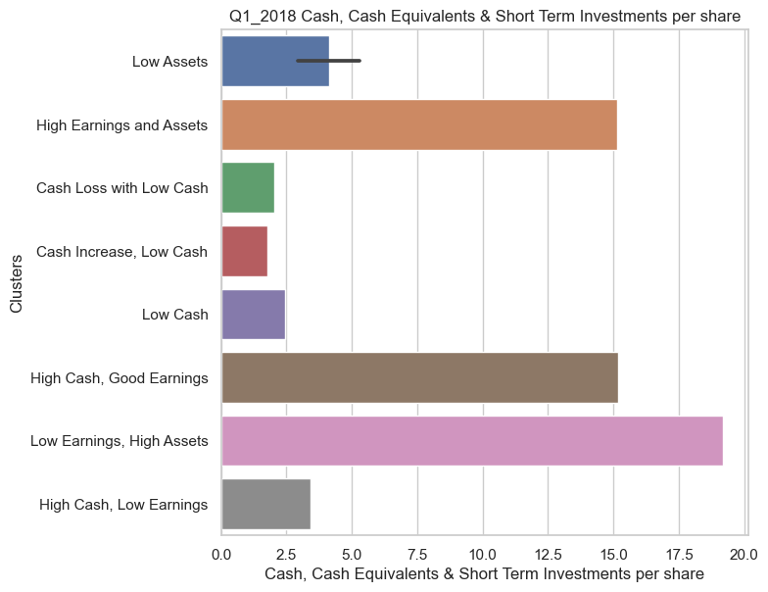
Q1 2018 Available Cash

Slide 13
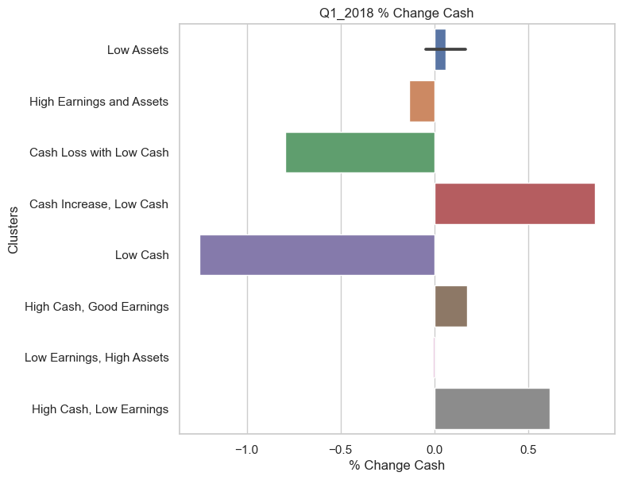
Q1 2018 % Change in Cash

Slide 14
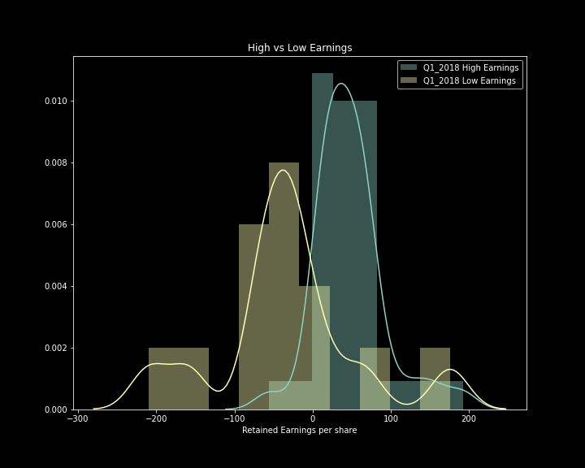
Q1 2018 Earnings

Slide 15
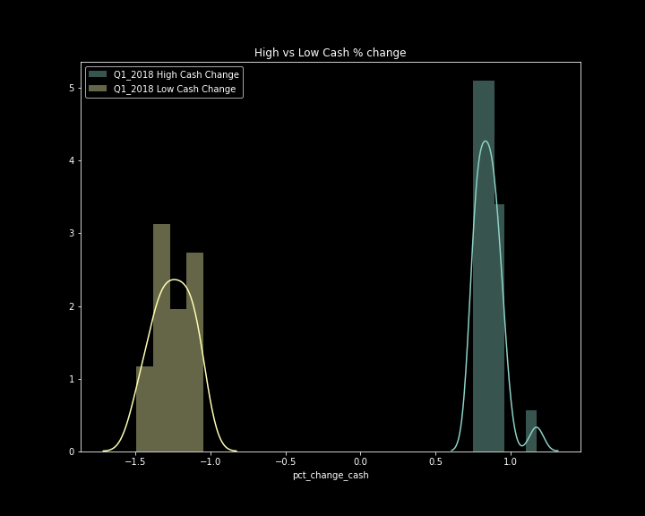
Q1 2018 % Cash Change

Slide 16
Core Findings
High performance (retained earnings) doesn’t cluster together
In general, earnings were not very different between the most distant clusters
Available cash change is interesting, especially with recent high levels of corporate debt.
Ultimately inconclusive without better data and a trading strategy to apply to the clusters.

Slide 17
Future Improvements
Better Data:
more quarters, more stocks, fewer missing data points
Allows for more advanced features to track movement
Add additional metrics
Dividends specifically
Add quarterly stock data
Quarterly relative volatility could be useful
Input cluster results into a trading algorithm to optimize clustering.

